Slide 1
Automated Software Test Generation:
Model-Based Testing
Cmpe 516- Fault Tolerant Computing
By Nedret ÖZAY

Slide 2
Outline
Introduction
Model-Based Testing(MBT)
  Models in SW Testing
  Finite State Machines
Fundamental Tasks of MBT
  Choosing the Model
  Building the Model
  Generating Tests
  Running Tests
  Collecting Results
Key Concerns and Closing Thoughts

Slide 3

What are the problems of Software Testing?
Time is limited
Applications are complex
Requirements are fluid

Slide 4

What is wrong with manual testing?
Testers are often perceived as bottlenecks to the delivery of software products. They are being asked to test more and more code in less and less time.

Slide 5
What is Test Automation?
Test automation is the use of software to control the execution of tests, the comparison of actual outcomes to predicted outcomes, the setting up of test preconditions, and other test control and test reporting functions.
Commonly, test automation involves automating a manual process already in place that uses a formalized testing process.

Slide 6

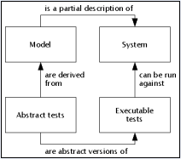
Model-Based Testing
One way to generate test cases automatically is “model-based testing” where a model of the system is used for test case generation.

Slide 7
Model-Based Testing
“Model-based testing is a testing technique where the runtime behavior of an implementation under test is checked against predictions made by a formal specification, or model.” - Colin Campbell, Microsoft Research
In other words:
  A model describes how a system should behave in response to an action.
  Supply the action and see if the system responds as you expect.

Slide 8
Models
Simply, a model of software is a depiction of its behavior. Behavior can be described in terms of the
  input sequences accepted by the system,
  the actions,
  conditions,
  output logic, or the flow of data through the application’s modules and routines.
By using modeling a shareable, reusable, precise description of the system is acquired.

Slide 9
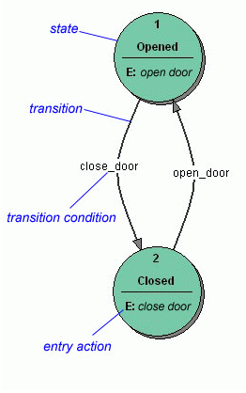
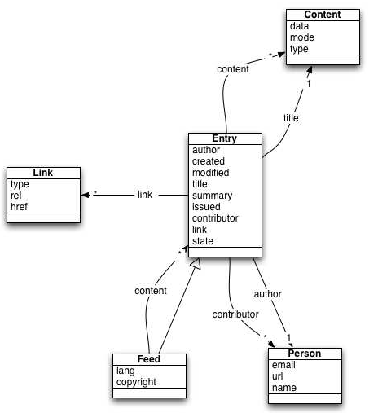
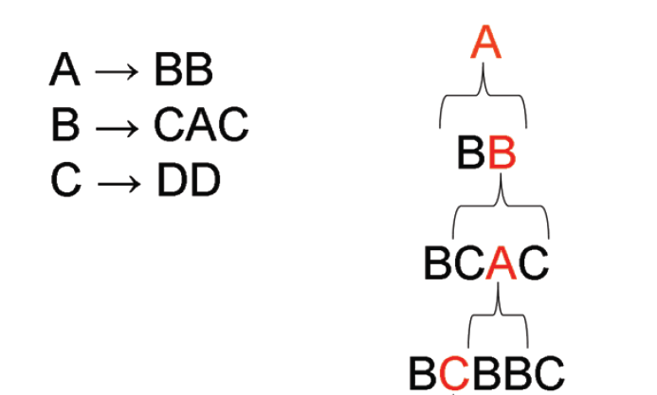
Models in SW Testing
Finite State Machines
Statecharts
UML
Markov Chains
Grammars

Slide 10
Finite State Machines
Formally a finite state machine representing a software system is defined as a quintuple (I, S, T, F, L), where
􀂉 I is the set of inputs of the system.
􀂉 S is the set of all states of the system.
􀂉 T is a function that determines whether a transition occurs when an input is applied to the system in a particular state.
􀂉 F is the set of final states the system can end up in when it terminates.
􀂉 L is the state into which the software is launched.

Slide 11
Example: Light Switch
Consider a simple light switch simulator:
The lights can be turned on and off using one input.
The intensity of the light can be adjusted using two inputs for decreasing and increasing the intensity.
There are three levels of light intensity: dim, normal, and bright.
If the lights are bright, increasing the intensity should not affect the intensity.
The simulator starts with the lights off. Finally, when the lights are
turned on, the intensity is normal by default, regardless of the intensity of the light when it was last turned off.

Slide 12
Example: Light Switch
“Light Switch” = (I, S, T, F, L), where:
I = {<turn on>, <turn off>, <increase intensity>, <decrease intensity>}
S = {[off], [dim], [normal], [bright]}
T:
<turn on> changes [off] to [normal]
<turn off> changes any of [dim], [normal], or [bright] to [off]
<increase intensity> changes [dim] to [normal], or [normal] to [bright]
<decrease intensity> changes [bright] to [normal], or [normal] to [dim]
The inputs do not affect the state of the system under any condition not described above
F = [off]
L = [off]

Slide 13
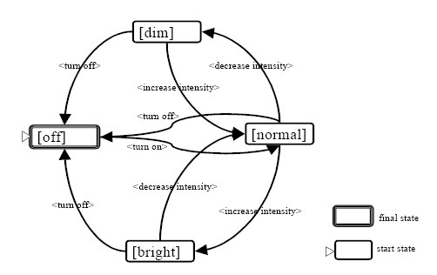
State Transition Matrix And State Transition Diagram
State \ Input | <turn on> | <turn off> | <increase intensity> | <decrease intensity>
[off] | [normal]
[dim] |  | [off] | [normal]
[normal] |  | [off] | [bright] | [dim]
[bright] |  | [off] |  | [normal]

Slide 14
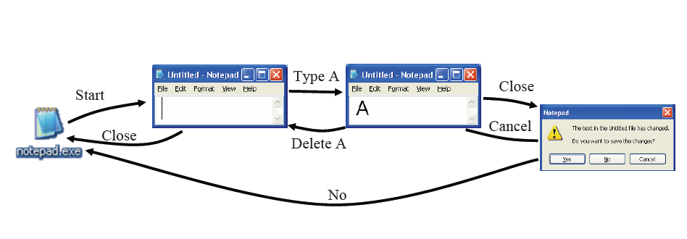
Example: Notepad

Slide 15
Fundamental tasks of MBT
Understanding The System: Forming a mental representation of the system’s
functionality is a prerequisite to building models. This is a nontrivial task as most systems today typically complex functionality. Moreover, software is deployed within gigantic operating systems among a clutter of other applications, dynamically linked libraries, and file systems all interacting with and/or affecting it in some manner.
  Determine the components/features that need to be tested based on test objectives.
  Start exploring target areas in the system.
  Establish communication with requirements, design, and development teams if possible.
  Identify the users of the system.
  Enumerate the inputs and outputs of each user.
  Study the domains of each input.
  Document input applicability information.

Slide 16
Fundamental tasks of MBT(cont’d)
  Document conditions under which responses occur.
  Study the sequences of inputs that need to be modeled.
  Understand internal data interactions and computation.
  Maintain one living document.
Choosing the Model: Not surprisingly, there are no software models today that fit all intents and purposes. Consequently, for each situation decisions need to be made as to what model (or collection of models) are most suitable.
  HTML files for a web browser or mathematical expressions for a scientific calculator: Grammar
  Phone systems etc.: Finite State Machine
  Parallel Systems: Statecharts (each component is a FSM)
  Systems that have intention of statistical analysis of failure data: Markov Chain

Slide 17
Fundamental tasks of MBT(cont’d)
Building the Model:
The general procedure that underlies many MBT methodologies:
  Make a list of the inputs.
  input applicability constraints for each input. For example, consider a simple telephone. The input “take the handset off the hook” can only be applied when the handset is hung up. (It is impossible to pick up the handset if the handset has already been picked up.)
  input behavior constraints for each input according to the current state context. For example, the input “take the handset of the hook” can cause a number of behaviors. If the context is that the phone is idle, the resulting behavior will be that the system will generate a dial tone. If the context is that the phone is ringing due to an incoming call, then the system will connect the two phones to allow conversation. Two different behaviors are caused by the same input.

Slide 18
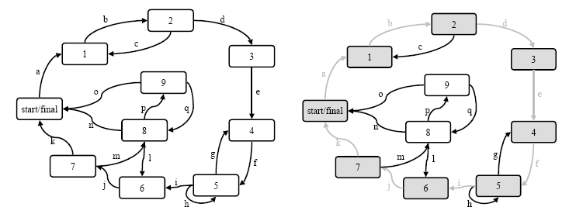
Generating Tests
In the case of finite state machines, traverse the state transition diagram. The sequences of arc labels along the generated paths are, by definition, tests. For example, in the state transition diagram below, the sequence of inputs “a, b, d, e, f, i, j, k” qualifies as a test of the represented system.
A state machine (left) and a test path in the state machine (right)

Slide 19
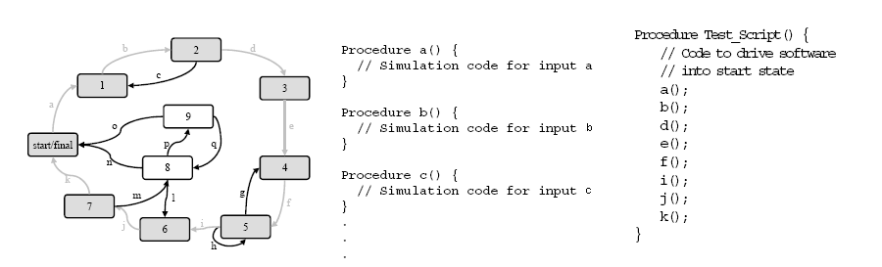
Running Tests
First, test scripts are written to simulate the application of inputs.
Next, the test suite can be easily translated into an executable test script.

Slide 20
Collecting Results
Evaluating test results is perhaps the most difficult testing process. Testers must determine whether the software generated the correct output given the sequence of test inputs applied to it.
In practice, this means verifying screen output, verifying the values of internally stored data and establishing that time and space requirements were met.
Verification of state can be used. For example, the model itself will catalog each state change that occurs (or should occur) in the software as test inputs are being applied. Thus, the model acts as a very precise and detailed specification, informing the tester what inputs should be available and the values of each data abstraction that comprises the state of the software under test.

Slide 21
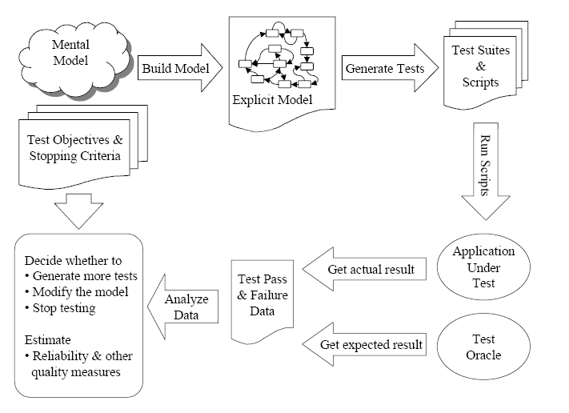
Collecting Results (cont’d)

Slide 22
Key Concerns
State Space Explosion: Number of states can be increased in a dramatical manner.
Solutions:
  Abstraction: Abstraction for MBT involves the incorporation of complex data into a simple structure. For example a dialog box that requires the entry of multiple fields of data followed by the OK button, could be modeled as two abstract inputs: “enter valid data” and “enter invalid data.”
  Exclusion: Simply dropping information without bothering to abstract it. This is mostly done when decomposing a set of software behaviors into multiple models. Each model will contain certain inputs and exclude others. The inputs excluded by a modeler would have to be tested in some other way, obviously.

Slide 23
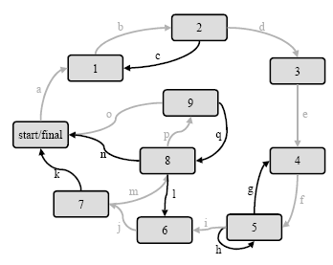
Key Concerns (cont’d)
Meeting Coverage Criteria
For state machines, coverage is expressed in terms of inputs, states, and transitions. For example, there is the criterion of covering all states.

Slide 24
Attractive Attributes of MBT
Succesfull applications when MBT was employed:
  Rosaria and Robinson (2000) on testing graphical user interfaces;
  Agrawal and Whittaker (1993) on testing embedded controller software;
  Avritzer and Larson (1993) and Dalal et al. (1998) on testing phone systems.
A model serves as a unifying point of reference that all teams and individuals involved in the development process can share, reuse, and benefit from. For example, confusion as to whether the system under test needs to satisfy a particular requirement can be resolved by examining the model.
Most popular models have a rich theoretical background that makes numerous tasks such as generating large suites of test cases easy to automate. For example, graph theory readily solves automated test generation for finite state machine models.

Slide 25
Difficulties and Drawbacks of MBT
Skills, time, and other resources need to be allocated for making preparations, overcoming common difficulties, and working around the major drawbacks.
This overhead needs to be weighed against potential rewards in order to determine whether a model-based technique is sensible to the task at hand.
Certain skills of testers (basic familiarity with formal languages, automata theory, and perhaps graph theory and elementary statistics).
The most prominent problem for state models (and most other similar models) is state space explosion. Briefly, models of almost any non-trivial software functionality can grow beyond management even with tool support.

Slide 26
Questions ?

Slide 27
References
http://en.wikipedia.org/wiki/Test_automation
http://en.wikipedia.org/wiki/Model-based_testing
http://www.model-based-testing.org
Ibrahim K. El-Far and James A. Whittaker , “Model-based Software Testing”, Encyclopedia on Software Engineering (edited by J.J. Marciniak), Wiley, 2001
L. Apfelbaum and J. Doyle, “Model-Based Testing”. Software Quality Week Conference. May 1997
H. Robinson “MBT Tutorial”, StarWest 2006
Alan Hartman IBM Israel – Haifa Research Laboratory, “Ten Years of Model Based Testing
A Sober Evaluation”, MBT 2006

